Slide 1
Long-term Warming and Nitrogen Deposition Drive Changes in Enzyme Activity
Anabel Evans​

Slide 2
INTRODUCTION
Anthropogenic activities disrupt the natural environment:
projected warming between 2 °C and 6 °C
release greenhouse gases: CO₂, CH₄, NO₂, H₂O, and O₃
increase in atmospheric temperature increases soil temperature
Carbon:
gives soils structure
increases productivity by creating diverse habitat for microbes
Soil Organic Matter:
healthy SOM is paramount to healthy plant growth
maintained through decomposition

Slide 3
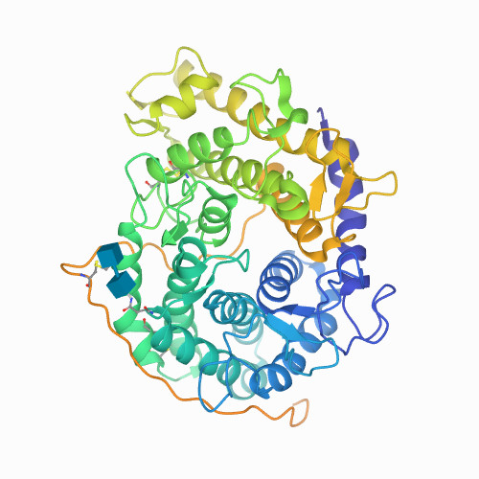
INTRODUCTION
Microbes decompose (SOM):
soil carbon cycle
makes nutrients readily available for plant use
Enzymes:
catalyze reactions in the soil
provide energy for microbes

Slide 4
REVIEW OF LITERATURE
Soil warming:
reduce substrate availability
reduced soil moisture
decline in rate of plant growth
in the short term, microbe activity, through the rate of soil enzyme activity, increases with warming (Wallenstein et al 2009)
in the long-term, as warming increases, enzyme activity will decline (Allison et al 2010b)

Slide 5
REVIEW OF LITERATURE
Nitrogen Deposition:
limits soil nutrients for terrestrial ecosystems
increased deposition correlates to warming soils
N deposition suppresses enzyme activity in leaf litter and lignin decomposition
(Whalen et al 2018), (Carreiro et al 2000), and (Talbot et al 2012)

Slide 6
HYPOTHESIS
Soil microbial enzyme activity decreases as a result of both soil warming and increased nitrogen deposition

Slide 7
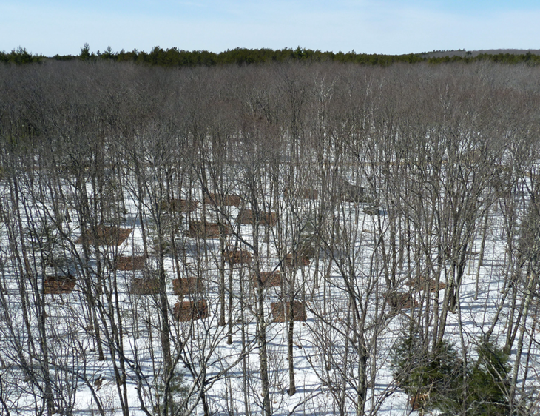
METHODOLOGY
Site Description: Prospect Hill Tract of the Harvard Forest Long Term Ecological Research Site in Massachusetts, USA
even-aged, mixed hardwoods
Soil type: fine, loamy and mixed mesic
Climate
Annual temperature: 7 °C (Contosta et al.)
Summer: high of 32 °C
Winter: low of -25 °C
Average total precipitation: 1100mm (Boose et al. 2002)

Slide 8
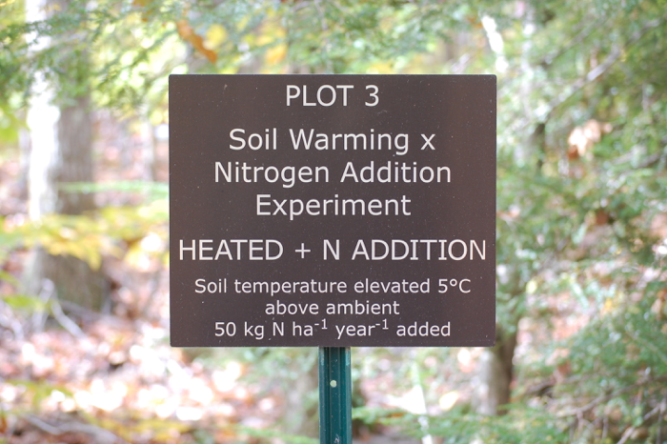
METHODOLOGY
Buried heating cables:
10 cm depth below the soil surface
spaced 20 cm
Nitrogen added to the plots as liquid
ammonium nitrate
Factorial treatment structure:
above ambient soil conditions for 14 years
+5 °C warming, +50 kg N ha⁻¹ year⁻¹

Slide 9
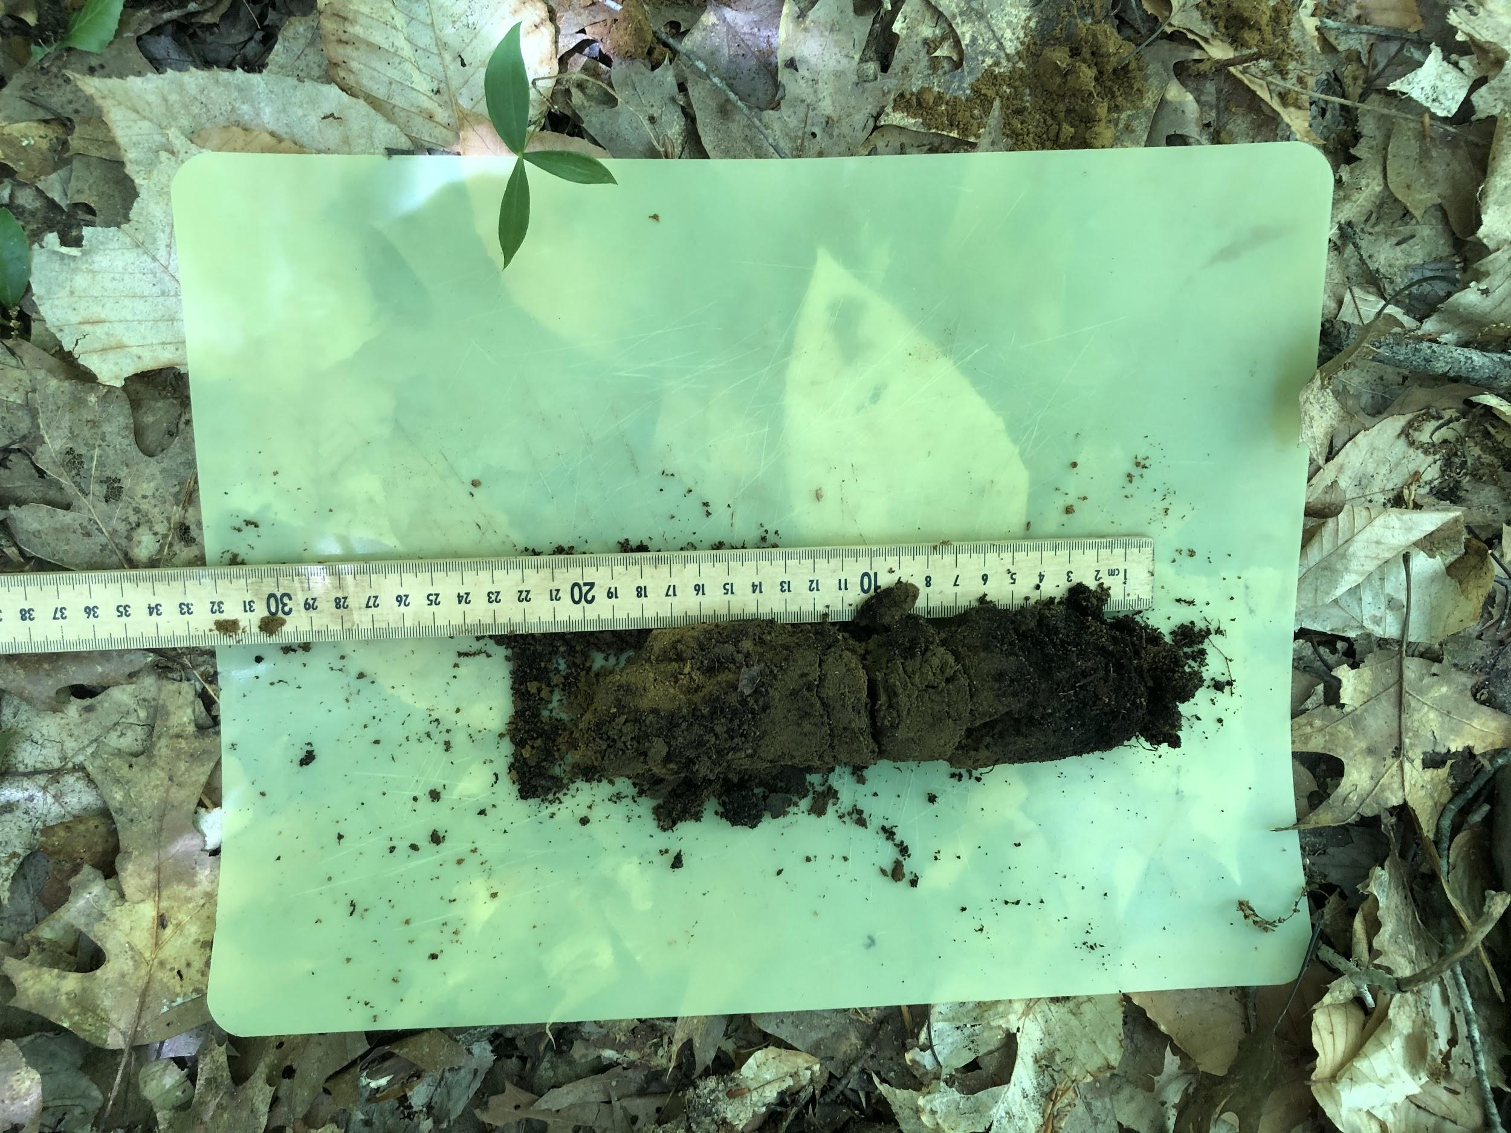
METHODOLOGY
SWaN experiment: 23 plots
6 controls
5 heated
6 nitrogen addition
6 heated with nitrogen
Collection:
organic horizon sampled in a 10 x 10 cm area
mineral horizon sampled to a depth of 20 cm
samples were stored at 4ºC
samples sieved:
rocks, roots, and other organic debris > 2 mm removed
stored at -80 ºC until soil enzyme assay was performed

Slide 10
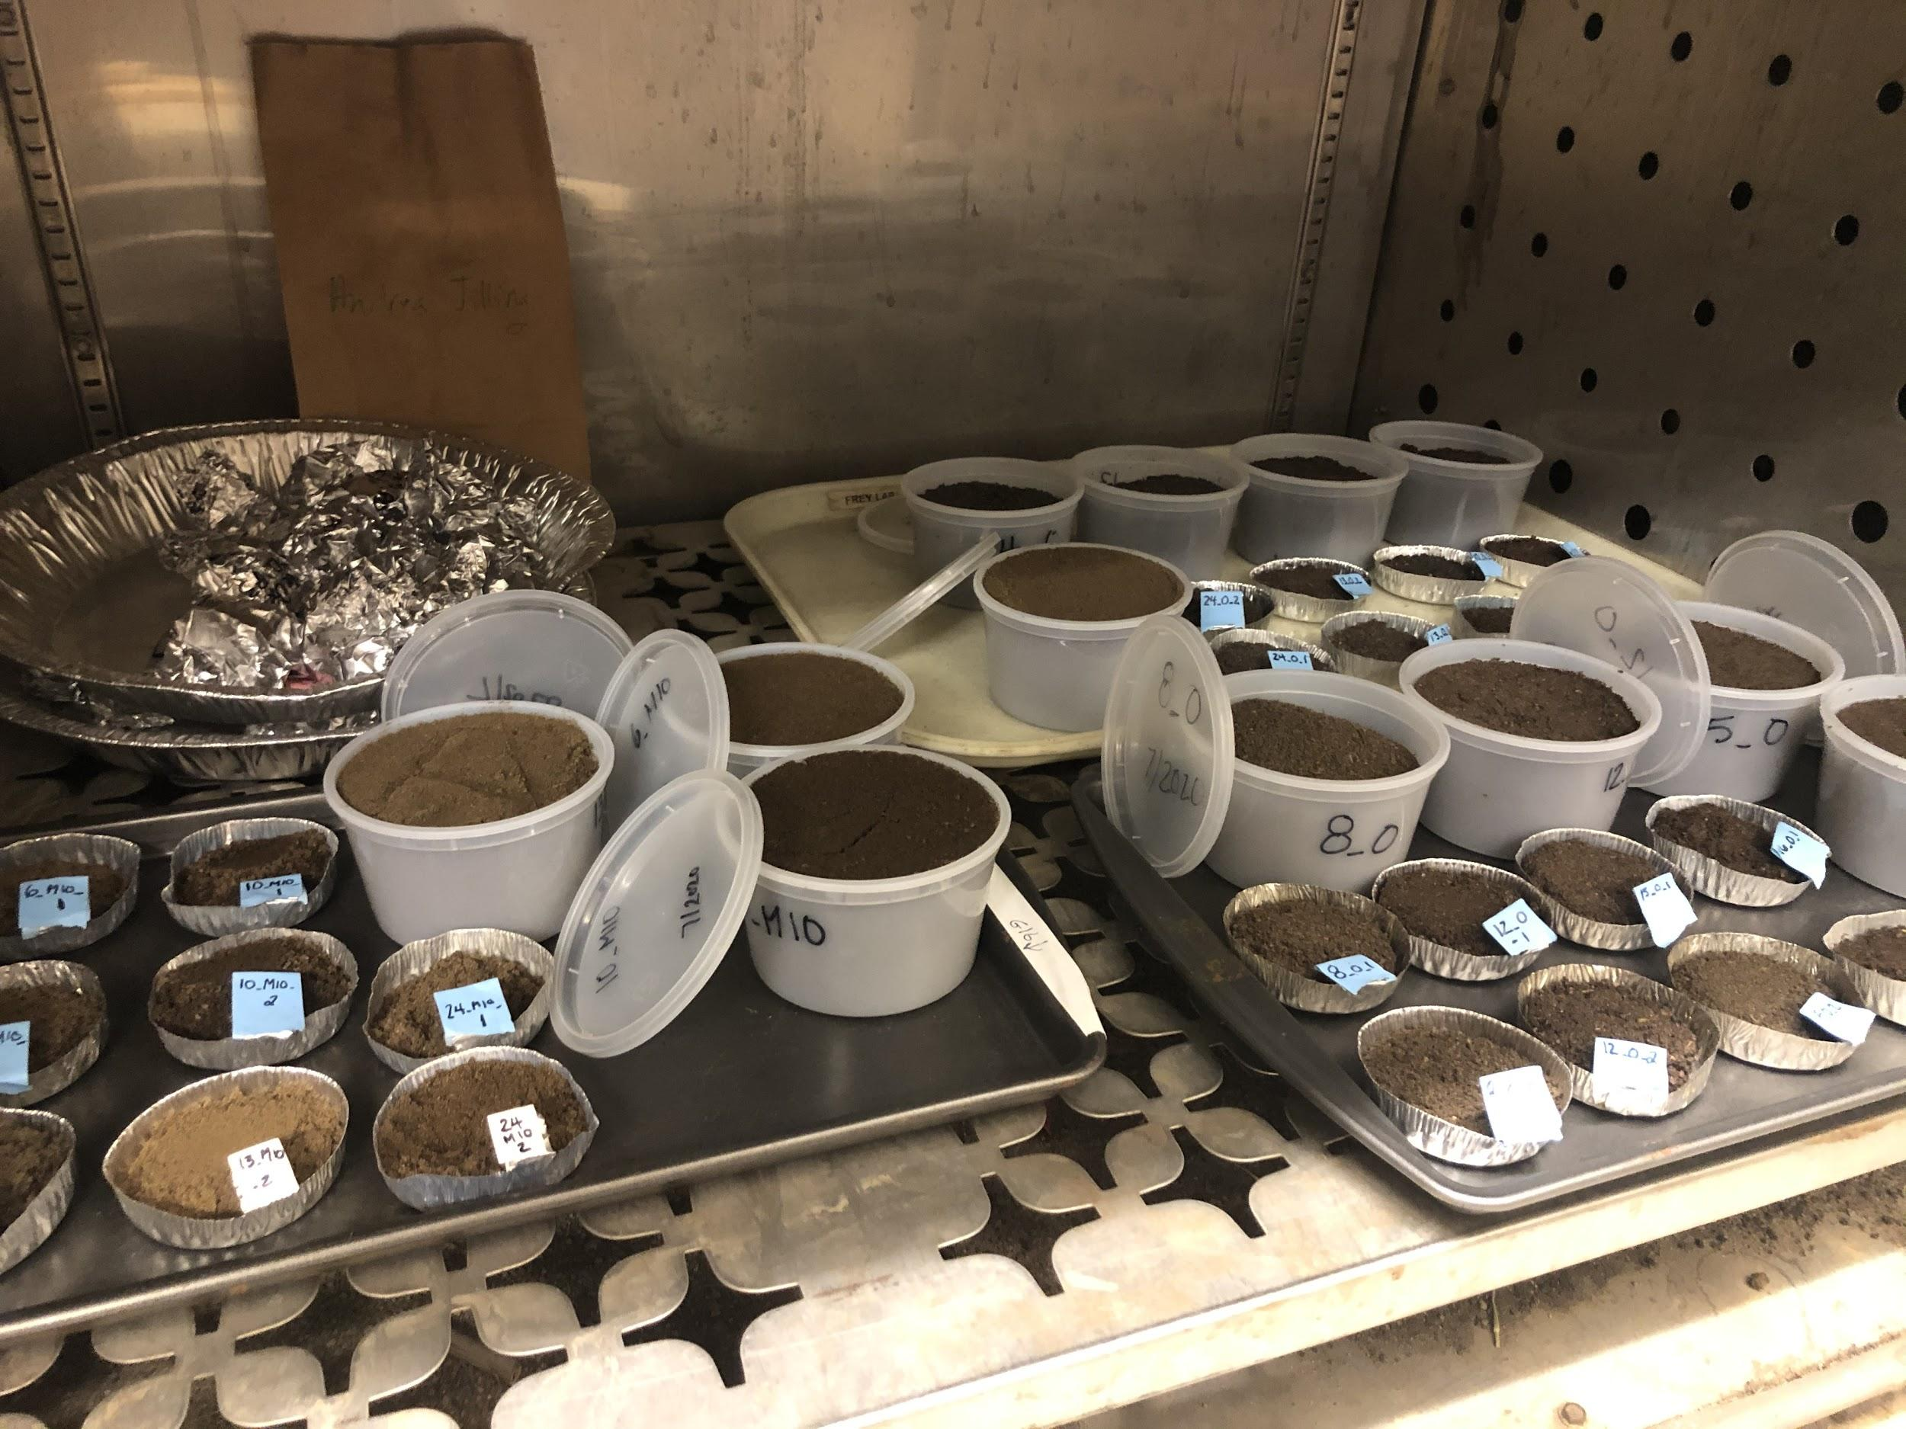
METHODOLOGY
Enzymes:
Cellobiohydrolase (CBH): degrades cellulose
β-D- glucosidase (BG): Degrades glucose bonds
N-acetyl-β-D-glucosidase (NAG): degrades chitin
Acid Phosphatase (PHOS): extracts phosphates from soil proteins
Fluorometric enzyme assay used to measure microbial enzyme activity
These units were then used to calculate final activity in μmols/g*hr

Slide 11
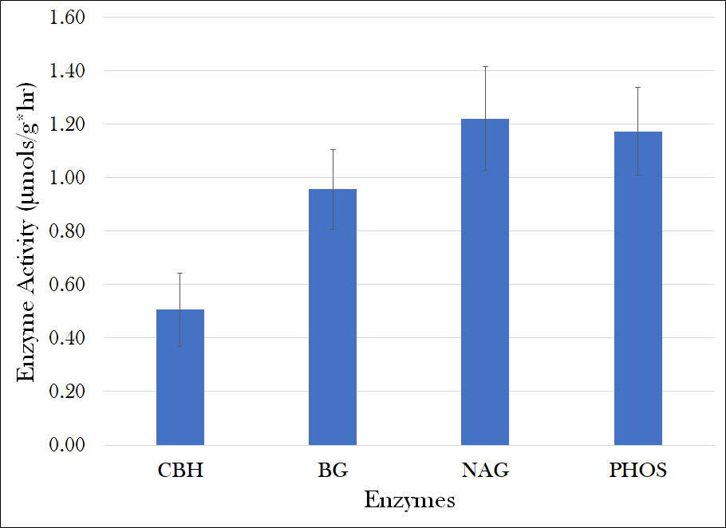
RESULTS
Average of the activity of all four enzymes in μmols/g*hr

Slide 12
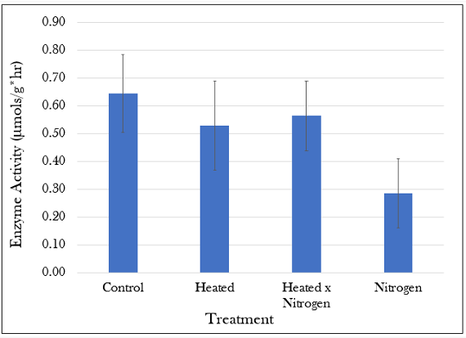
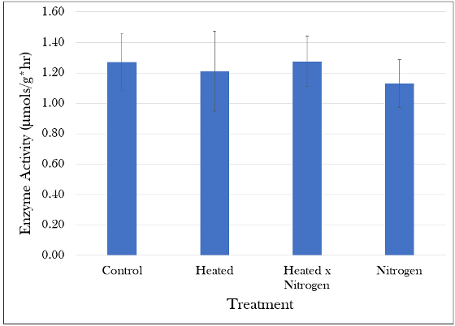
RESULTS
CBH
Least activity overall
NAG
Greatest activity overall with minimal variation

Slide 13
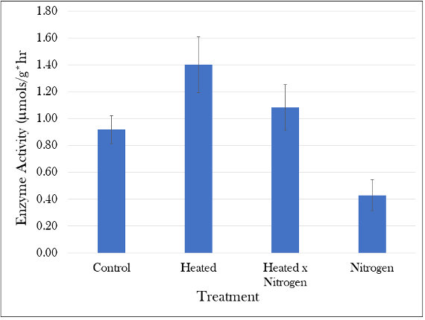
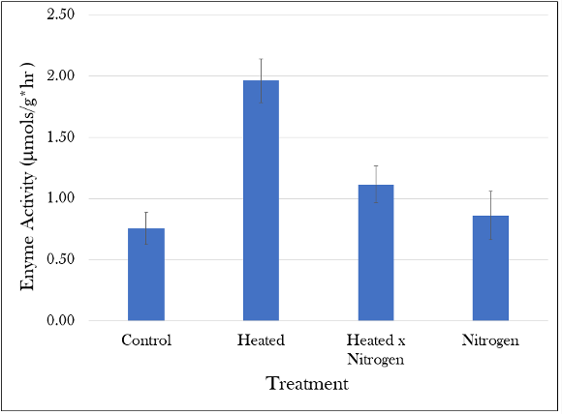
RESULTS
BG
Responded most to all three treatments
PHOS
Increased with warming and decreased with N deposition

Slide 14
DISCUSSION
EEA response to treatment varied amongst enzymes
Each enzyme plays a different role in nutrient cycling in the broader ecosystem
soil C, P, and the pH may influence variation in enzyme activity
NAG degrades some of the most persistent compounds in the environment
low PHOS activity with nitrogen deposition
increase of PHOS with warming
increase of BG with warming
Notes:
system is not in demand of phosphorous indicating that N is the limiting nutrient in these systems
demonstrates an increased demand for phosphorous
greater demand for simple carbohydrates, which are important nutrients for this enzyme

Slide 15
DISCUSSION
Root and mycelial presence could also have an effect on enzyme activity
Mycorrhizal colonization rates in the same soils:
decline under warming and nitrogen addition alone
significantly increase when soils are warmed and fertilized simultaneously

Slide 16
CONCLUSION
Hypothesis
supported:
nitrogen deposition seemed to reduce enzyme activity to the largest degree for CBH, NAG, and PHOS
NAG and CBH decreased with warming
not supported:
BG and PHOS increased with warming
The combination of warming and Nitrogen had an antagonistic effect on EEA
Future Work:
Assess soil conditions as a factor

Slide 17
CITATIONS
Allison, S.D., Wallenstein, M.D., Bradford, M.A., (2010b). Soil-carbon response to warming dependent on microbial physiology. Nature Geoscience, (3), 336-340.
Carreiro, M.M., Sinsabaugh, R.L., Repert, D.A., Parkhurst, D.F., (2000). Microbial enzyme shifts explain litter decay responses to simulated nitrogen deposition. Ecology (81), 2359-2365.
Contosta, A., Frey, S., Cooper, A., (2011). Seasonal dynamics of soil respiration and N mineralization in chronically warmed and fertilized soils. Ecosphere 2 art36.
Peterjohn, W.T., Melillo, J.M., Steudler, P.A., Newkirk, K.M., Bowles, F.P., Aber, J.D., (1994). Response of trace gas fluxes and N availability to experimentally elevated soil temperatures. Ecological Applications, (4), 617-625.
Talbot, J.M., Treseder, K.K., (2012). Interactions among lignin, cellulose, and nitrogen drive litter chemistry–decay relationships. Ecology, 93(2), 345–354
Wallenstein, M.D., McMahon, S.K., Svhimel, J.P., (2009). Seasonal variation in enzyme activities and temperature sensitivities in Arctic tundra soils. Global Change Biology, (15), 28-38.
Whalen, E. D., Smith, R. G., Grandy, A. S., & Frey, S. D. (2018). Manganese limitation as a mechanism for reduced decomposition in soils under atmospheric nitrogen deposition. Elsevier, Soil Biology and Biochemistry (127), 252-263.

